Slide 1
IBM University Engagement Project Submission “Exploring the Power of Agentic AI with IBM Granite and LangFlow”

Slide 2

Project Title - Fitness Buddy Domain of Project – Agentic AI, Wellness, Healthcare
Student Name | Passport Photo | Email ID | Mobile Number
SRILEKHA S |  | srilekhas118@gmail.com | 8608600680

Slide 3
Problem Statement Fitness Buddy
Challenge
In today's fast-paced world, many individuals struggle to maintain a healthy lifestyle due to lack of personalized guidance, time constraints, and inconsistent motivation. Traditional fitness solutions often require expensive subscriptions, in-person consultations, or rigid schedules that don't adapt to personal preferences or daily routines.
There is a growing need for an accessible, friendly, and intelligent virtual assistant that can provide on-demand fitness advice, healthy lifestyle suggestions, and basic nutrition guidance- all tailored to individual needs and available at any time.
Fitness Buddy aims to solve this problem by offering a conversational, AI-powered health and fitness coach that can:
Recommend home workouts and routines based on user input.
- Provide motivational tips and daily fitness inspiration.
- Suggest simple, nutritious meal ideas.
- Encourage habit-building and consistency.

Slide 4
Technology Used
Key Platforms Used:
IBM Cloud Lite: Provides the foundational cloud infrastructure and secure authentication pipelines.
IBM watsonx Orchestrate: Acts as the conversational agent container and deployment frontend platform.
IBM Granite Model: Serves as the core Large Language Model (LLM) reasoning brain for text generation .
Langflow: Used as the low-code, drag-and-drop visual pipeline engine to design agentic workflows.
GitHub: Repository host for version control and project manifest storage (app.json).

Slide 5
Proposed Solution
Retrieval-Augmented Generation (RAG): Connects a targeted, local knowledge base (fitness_manual.txt) directly to the agent container to deliver fast, reliable data without model hallucinations.
Conversational Assistant: An interactive chat panel that cleanly interprets natural user phrases like "give me a home workout" or "I need simple recipes.“
Zero-Equipment Workouts: Automatically outputs structured 15-minute bodyweight routines, macro-balanced nutrition guides, and daily behavioral motivation triggers.

Slide 6
Langflow component Used
Chat Input Node: Captures real-time natural language query strings directly from the live chat UI.
Prompt Node: Holds the system instructions grounding the AI agent's behavior persona as an expert personal trainer.
IBM watsonx.ai / LLM Node: Connects securely via an API key to run token parsing using the IBM Granite foundation model [📡].
Chat Output Node: Renders the final markdown-formatted text response stream back to the terminal.

Slide 7
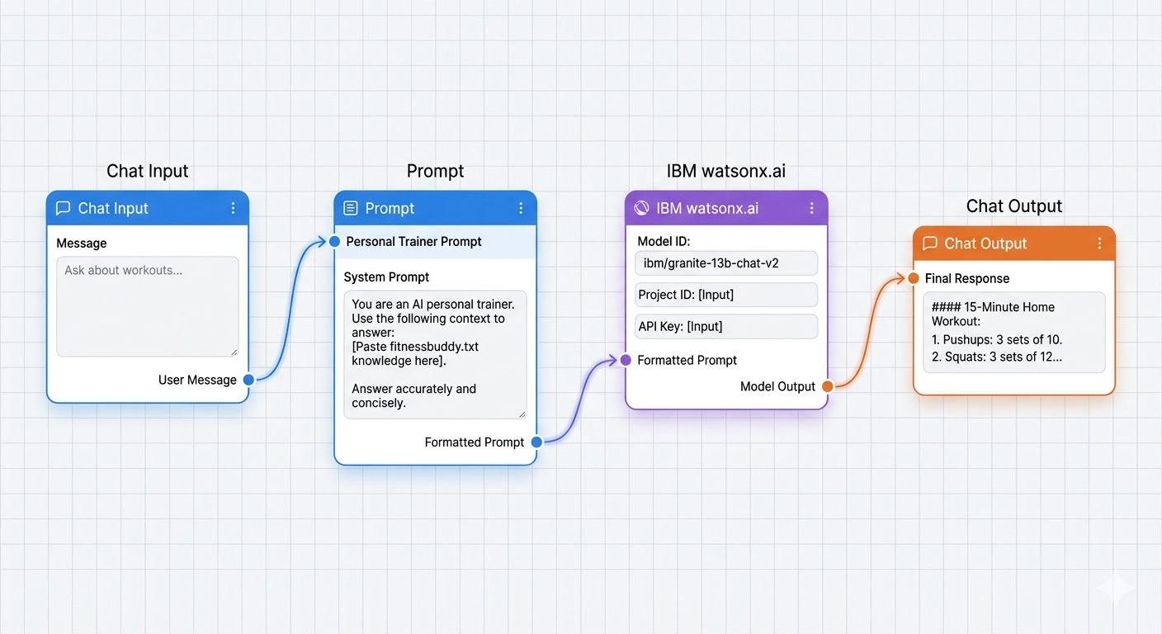
Langflow workflow

Slide 8
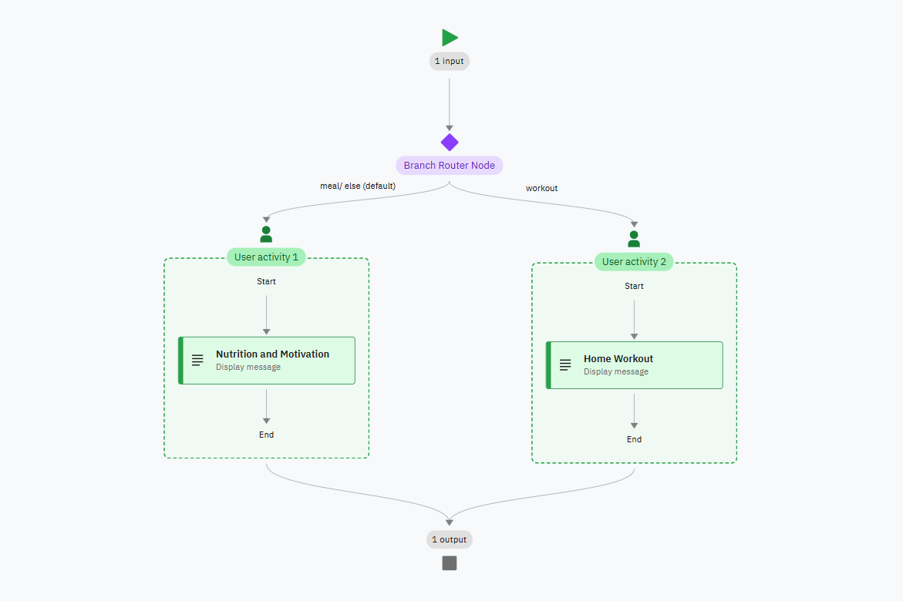
Architecture blueprint

Slide 9
Role of Agentic AI in the solution
Autonomous Decision Making: The system moves beyond linear chatbots by dynamically choosing the correct execution path based on the user's message context.
Orchestration over Coding: Uses drag-and-drop orchestration blocks to bridge intent parsing with complex data lookup pipelines seamlessly.
Predictable Executions: Lowers model hallucinations by keeping the AI agent safely restricted within predefined guardrails, system instructions, and fallback rules.

Slide 10
Technology Used
Langflow Platform: Low-code visual pipeline orchestrator used to design and wire the agentic logic canvas.
IBM Granite Model: The foundational Large Language Model (LLM) serving as the core reasoning engine.
IBM Cloud: Secure enterprise hosting provider managing access key structures and Lite infrastructure parameters.
Retrieval-Augmented Generation (RAG): Architecture patterns used to connect localized knowledge text to the active agent container.
IBM watsonx.ai: The runtime machine learning workspace platform processing the model prompts and inference parameters.
Vector Database: High-performance semantic vector index layer storing the partitioned fitness data arrays.

Slide 11
Novelty and Uniqueness
Contextual Intelligence Routing: Instead of relying on rigid, keyword-matching engines or linear tree logic, the platform utilizes advanced token parsing to route dynamic user intents autonomously.
Zero-Overhead Infrastructure: Built entirely on IBM Cloud Lite [📡]. It eliminates the need for expensive, round-the-clock server hosting while maintaining enterprise-level deployment readiness.
Seamless No-Code/Low-Code Hybrid Integration: Uniquely blends the visual drag-and-drop flexibility of Langflow with the structured deployment manifest layers of watsonx Orchestrate to establish a scalable development pipeline.
Hallucination Defences: Combines localized RAG parameters with robust behavioral fallback rules to ensure all workouts, recipes, and instructions stay within accurate safety boundaries .

Slide 12
Git Hub Link
Repository URL: 👉 https://github.com/srilekhas118/Fitness-Buddy
Core Repository Deliverables:
app.json: Industry-standard deployment manifest file automating environment variable parameters .
README.md: Fully-grounded technical project overview documentation mapping project infrastructure.
Fitness_manual.txt: Vectorized knowledge base reference dataset containing the core fitness manual guidelines.
Problem_Statement.pdf: Official audit documentation for Problem Statement

Slide 13
Future Scope
Wearable IoT Device Integration: Connecting backend API scripts directly to smartwatches (Apple Watch, Fitbit) to pull real-time biometric metrics like heart rate or caloric burn.
Advanced Vector Database Expansion: Migrating from text files to managed vector engines like IBM watsonx.data or Milvus to store vast catalogs of dynamic exercise videos and macro recipes.
Multi-Modal Computer Vision Analysis: Integrating camera inputs to let the Agentic AI analyze user workout postures live and offer real-time form correction suggestions.
Automated Multi-Channel Communication: Expanding channel integrations so the fitness coach can autonomously text progress updates or email personalized shopping lists via WhatsApp or Twilio.

Slide 14
Thank You !
Thank you for your time and interest.

